Slide 1



Predict the virality of hashtags in a social network
Statistical Analysis of Network Data with Applications in Marketing
Lightning presentation
Duc-Vinh TRAN
Maxence BROCHARD
Samy BOUCHNAIF
04/21/2017
1

Slide 2

The project goals
I.
Introduction
Data presentation
II.
Motivations
Project phases
References
Sources & description
Simple analysis & sampling
III.
Modeling & prediction
Modeling of hashtags spreading
Prediction of infection
2

Slide 3

I. Introduction: Modeling hashtag spreading as a disease propagation
3

Slide 4
Context & Motivations
Virality is key to companies
How to catch attention and spread their message?
How does the structure affect the diffusion?
How to model the contagion?
Does network structure has an influence? Which formalisms?
4

Slide 5



The broad idea: network communities allow predict virality by its early spreading pattern.
Introduction
How to predict/modelize the contagion?
Modeling a contagion system by applying an epidemic model to a dataset:
Which size? Do we need sampling?
How to define a community? Delimitation of the concerned subgraph.
4

Slide 6
II. Data presentation: Hashtags spreading in Twitter sampled network
7

Slide 7


Data description
EXPLORATION
Source :
Size : more than 1M # !
Aim : modelizing # spreading in the sampled network
- Looking for some viral #
- Extracting the subnets: boundaries?
- Working on them
8

Slide 8
III. Modeling and prediction: Modeling of hashtags spreading in Twitter sampled network
12

Slide 9
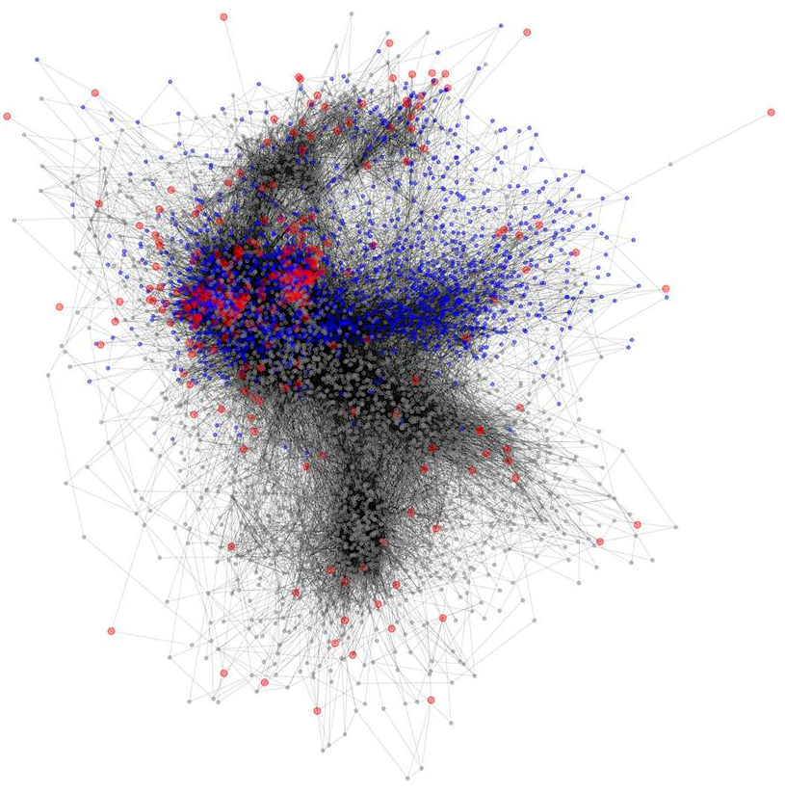
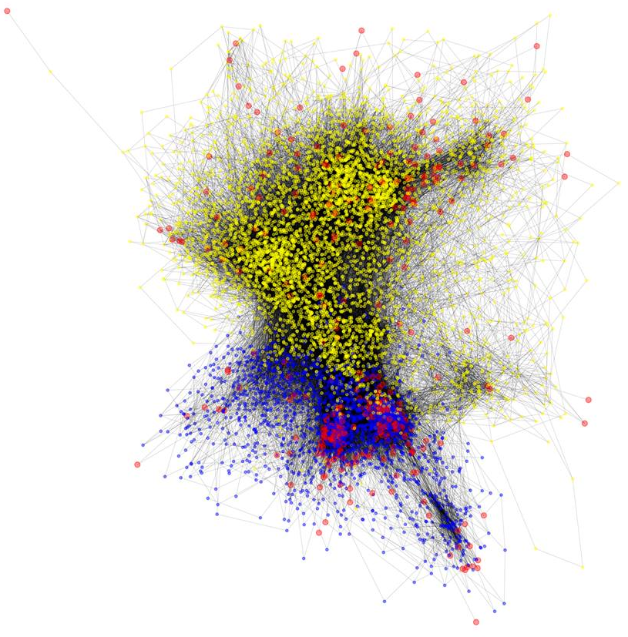
EXPLORATION : EXAMPLES OF # MODELING
#bbc #news
#bbc #madonna
Infected nodes in red
8

Slide 10
Machine learning to predict the virality of a brand new # ?
PREDICTION OF INFECTION
Steps
Cleaning and preparing the data
Learning model choice
Optimization
Already started
Further improvements coming
Testing multiples ML models and choosing the right one
Testing multiples network representations
Optimize our algorithm to make it efficient regarding on large amounts of data
17

